Slide 1



Body Lotion Dataset – Exploratory Data Analysis (EDA)

Slide 2
About me
MySelf Neha Polapally, I have completed B.com General in 2023 from A.V college
It offers high-demand, well-paying jobs across many industries, provides valuable analytical and problem-solving skills applicable to personal and professional growth, empowers you to drive innovation and make informed decisions, and allows you to contribute to addressing major societal challenges. The field provides robust career opportunities with high growth potential and flexibility.
Process Executive Data(9 Months) at Cognizant Present.
Associate Analyst at Deloitte.

Slide 3
Problem Statement
Customers choose products based on price, reviews, and brand.
Analyze how price, discounts, and ratings influence customer choice.
Identify patterns and insights to optimize pricing and marketing strategies

Slide 4
Objective of the Project
Collect data on body lotions from e-commerce websites.
Perform data cleaning and transformation.
Conduct EDA to extract insights on pricing, discounts, and brand competition.
Address key business questions: Which price ranges and discounts attract customers most?

Slide 5
Web Scraping (Details)
Source Website: Nykaa (Body Lotion category).
Tools/Processor: Python, requests, BeautifulSoup, pandas,Numpy,Matplotlib,Seaborn
Steps Followed:
Crawled product listing pages.
Extracted details → Product Name, Price, Selling Price, Discount, Ratings.
Stored data in CSV for analysis.

Slide 6
Summary of the Data
Records: 784 products.
Features/Columns: 8 (ProductName, Brand, Price, SellingPrice, Discount, Savings, PriceCategory, RatingCount).
Price range: ₹100 – ₹1500.
Discounts: 0% – 60%.

Slide 7
Data Cleaning
Removed unwanted characters (₹, %, “off”).
Converted Price, Discount, Savings into numeric format.
Handled missing/null values.
Removed duplicate records.

Slide 8
Data Manipulation
Added PriceCategory: Budget, Mid-range, Premium.
Calculated Savings column.
Standardized brand names.
Sorted dataset for structured analysis.

Slide 9
Univariate Analysis
Definition: Univariate analysis examines each variable individually.
Purpose: Helps understand distribution, central tendency, spread, and outliers.
Methods:
For Numeric Variables → Histograms, Boxplots.
For Categorical Variables → Bar charts, Pie charts.

Slide 10
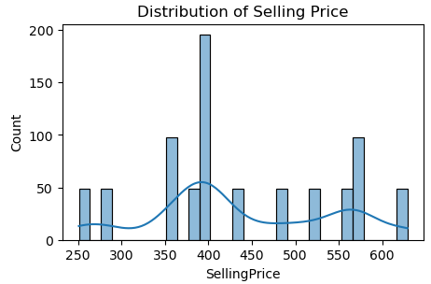
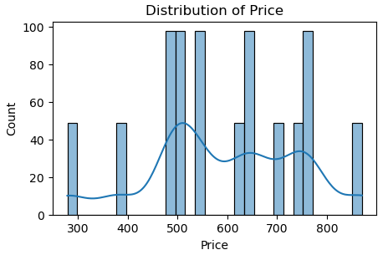
1.Histogram & KDE for Selling Price, Discount, Price, Ratings Count, Savings 2. Boxplot for Discount, Price, Ratings Count, Savings,Selling Price
1. Histogram

Slide 11
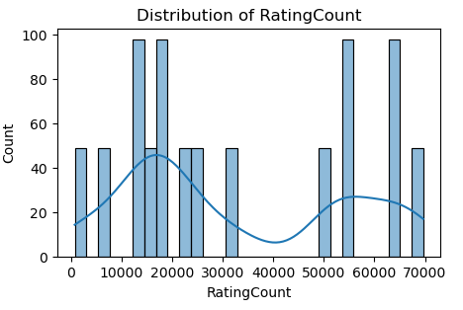
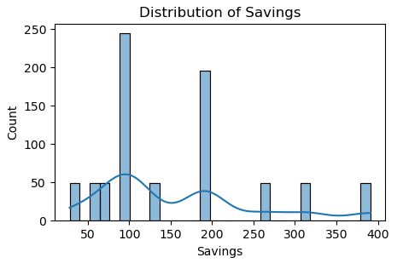
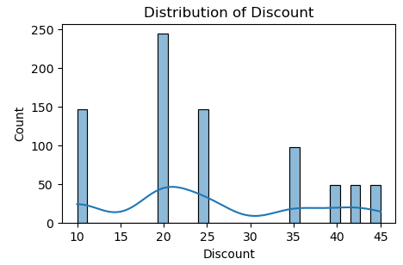

Slide 12
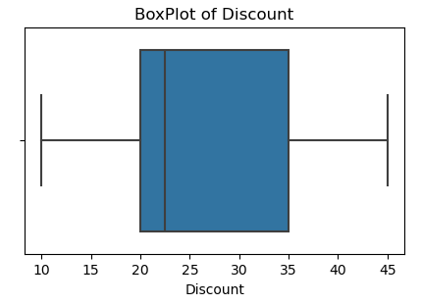
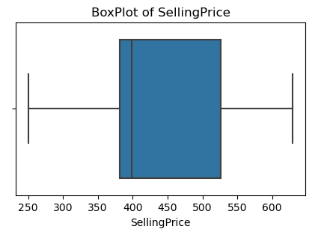
2.Boxplot

Slide 13
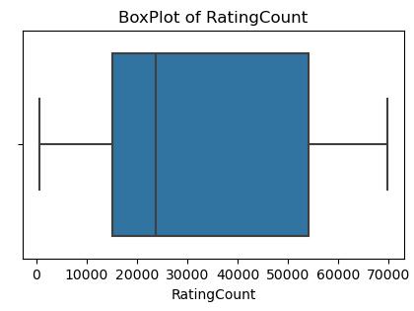
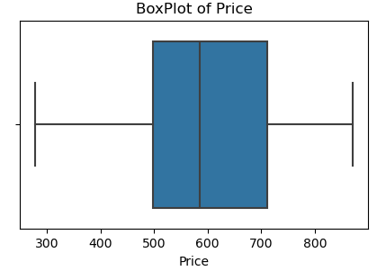
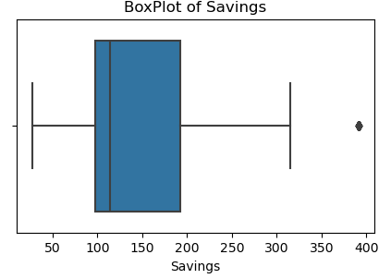

Slide 14
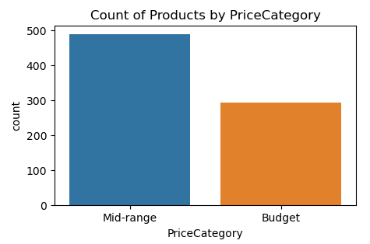
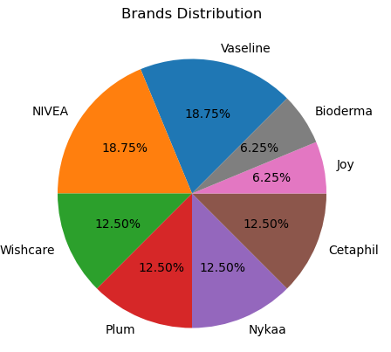
1. Count plot for Price Band 2. Pie chart for Brands Distribution
1)
2)

Slide 15
Bivariate Analysis
Definition:Bivariate analysis studies the relationship between two variables at the same time.
Purpose:To find associations, trends, or patterns between variables.
To check if one variable affects the other.
To support decision-making and predictions.
Methods:
Numerical vs Numerical → Correlation, Scatter Plot.
Categorical vs Numerical → Boxplot.
Categorical vs Categorical → Stacked Bar Chart, Heatmap.

Slide 16
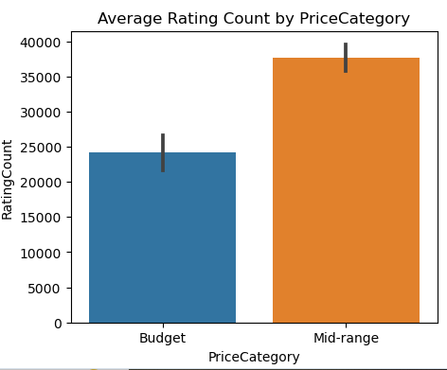
Categorical vs Numerical
There is a positive relationship between PriceCategory and RatingCount — Mid-range products tend to receive more user ratings on average compared to Budget products.

Slide 17
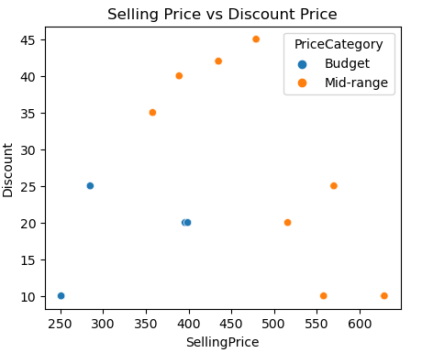
Numerical vs Numerical
The image shows a weakly positive correlation between Selling Price and Discount.

Slide 18
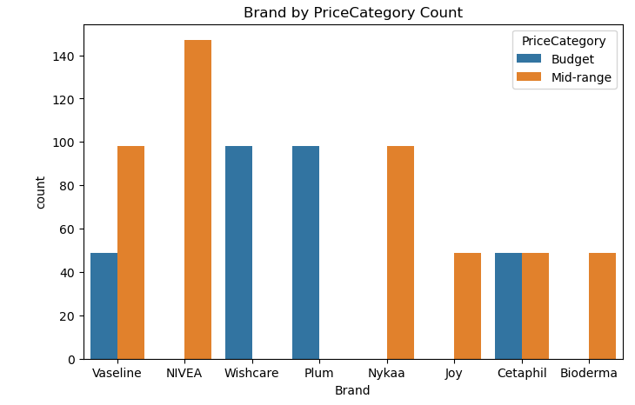
Categorical vs Categorical
Brand by PriceCategory
Plum and Wishcare are budget friendly.

Slide 19
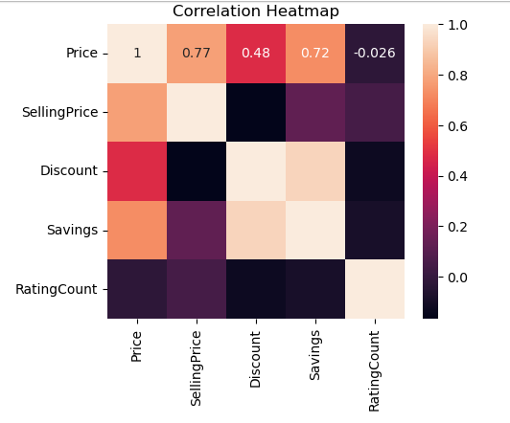
Multivariate Analysis - Correlation
1.Price vs SellingPrice (0.77)- Strong positive relationship.
2.Price vs Discount(0.48) - Moderate positive relationship.
3.Price vs Savings(0.72) - Strong positive relationship.
4.Price vs RatingCount (-0.026) -no correlation.
5.SellingPrice vs RatingCount (0.0) - Very weak or no correlation.

Slide 20
KEY BUSINESS QUESTIONS
How do price and discounts influence customer choices across different brands?
Which brands rely more on discounts vs. brand trust to attract customers?
How do ratings vary across brands and price categories?
What pricing and discounting strategies differentiate budget vs. mid-range products?
Which brands cover multiple segments (budget & mid-range), and which are positioned exclusively?

Slide 21


Slide 22
Conclusion
Strong brands win on trust, not discounts.
Discounts help budget brands compete but don’t ensure high ratings.
Segmented pricing strategies allow brands like Vaseline & Wishcare to tap both budget and mid-range markets.

Slide 23
Experience
Learned to collect real-world product data (price, discount, brand, ratings) using web scraping techniques.
Understood how to clean raw data (removing symbols like ₹, %, handling missing values, formatting columns).
Applied EDA (Exploratory Data Analysis): univariate, bivariate, multivariate analysis with plots (boxplots, scatter plots, heatmaps, bar charts).
Improved Python, Pandas, Matplotlib, Seaborn skills for analysis and visualization.

Slide 24
Challenges
Avoiding duplicate/blank values in scraped data.
Dealing with HTML tag changes which broke extraction scripts.
Removing unwanted text (e.g., “₹”, “% off”, brackets in ratings).
Converting data types (strings → numeric) for calculations.
Handling missing / inconsistent data across brands.
Choosing the right plots to represent patterns clearly.

Slide 25

THANK YOU

